Slide 2
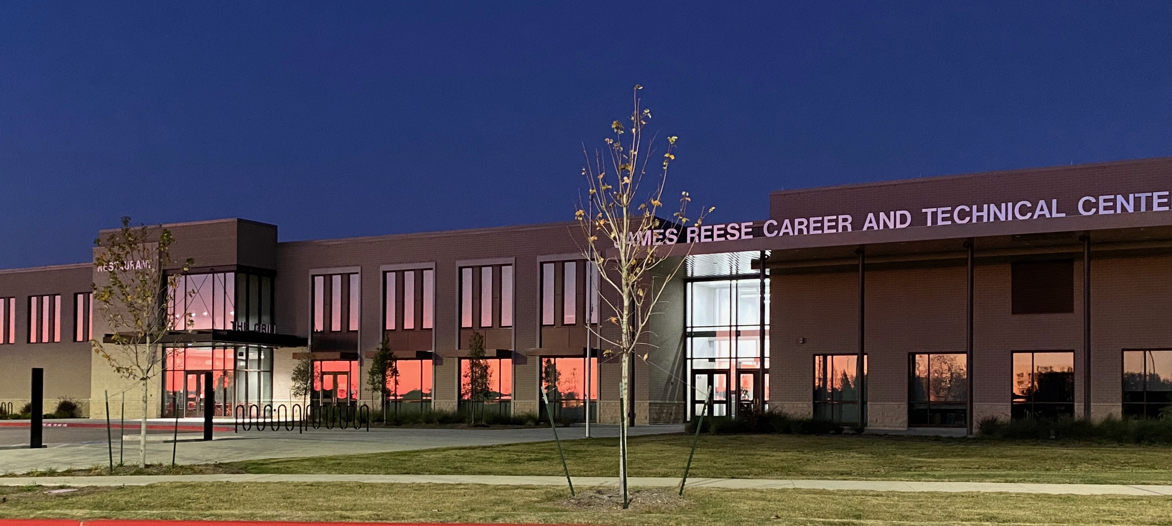

Slide 3
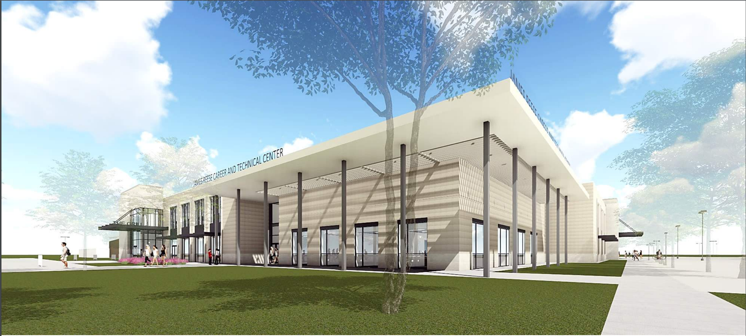
CTE Mission Statement:
Fort Bend ISD Career and Technical Education (CTE) provides every student with challenging career pathways utilizing real world practices and evolving skill sets, attitudes, and behaviors.
JRCTC Mission Statement:
Empowering students with life-long skills today to become industry leaders tomorrow
It is the policy of this school district not to discriminate on the basis of gender, race, handicap, color, or national origin in its educational and vocational programs, activities, or employment as required by title IX, Section 504, and title VI.

Slide 4
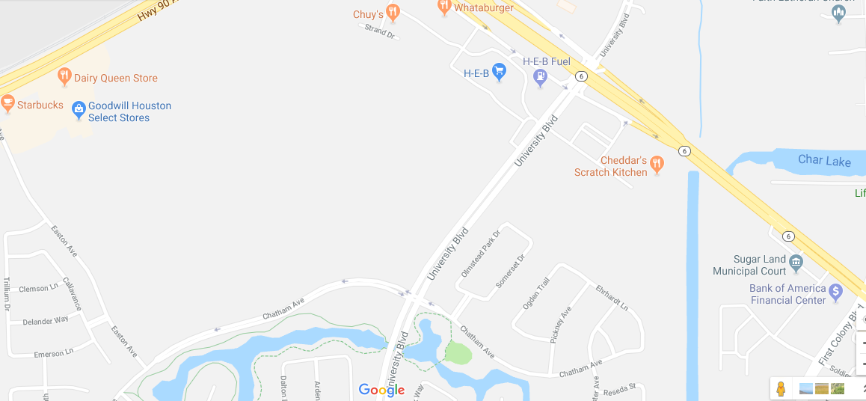
What is the James Reese Career and Technical Center?
Central site/campus for specialty Career and Technical Education (CTE) courses located at intersect of University Boulevard and Chatham Avenue.
New, state-of-the-art facility opened in Fall 2019.

Slide 5
What pathway and course opportunities will be available at the Reese Center?
Animal Science Pathway
Vet Med
Education and Training
Instructional Practices
Practicum in Education and Training
Healthcare Therapeutic Pathway
Practicum in Health Science
Digital Communications Pathway
Audio/Video Production I + Lab
Audio/Video Production II + Lab
Culinary Arts Pathway
Culinary Arts
Advanced Culinary Arts
Practicum in Culinary Arts
HVAC and Sheet Metal Pathway
Principles of Construction
HVAC I
HVAC II
Electrical Pathway
Principles of Construction
Electrical I
Electrical II

Slide 6
What pathway and course opportunities will be available at the Reese Center?
Business Management Pathway
Career Prep
Marketing & Sales Pathway
Career Prep
Architectural Design Pathway
Career Prep
Cosmetology Pathway
Principles of Cosmetology
Cosmetology I
Cosmetology II
Networking Systems Pathway
Principles of Information Technology
Computer Maintenance + Lab
Networking + Lab
Welding Pathway
Introduction to Welding
Welding I
Welding II
Automotive Pathway
Automotive Technology I
Automotive Technology II
Practicum in Transportation Systems
Diesel and Heavy Equipment Pathway
Diesel I
Diesel II
Practicum in Transportation Systems

Slide 7
Emergency Services Pathway
Home Campus Prerequisites:
9th: Principles of Law and Public
10th: Disaster Response
Reese courses 2023-2024
Anatomy & Physiology
Emergency Medical Technician-Basic
Practicum in Law, Public Safety, Corrections, and Security

Slide 8
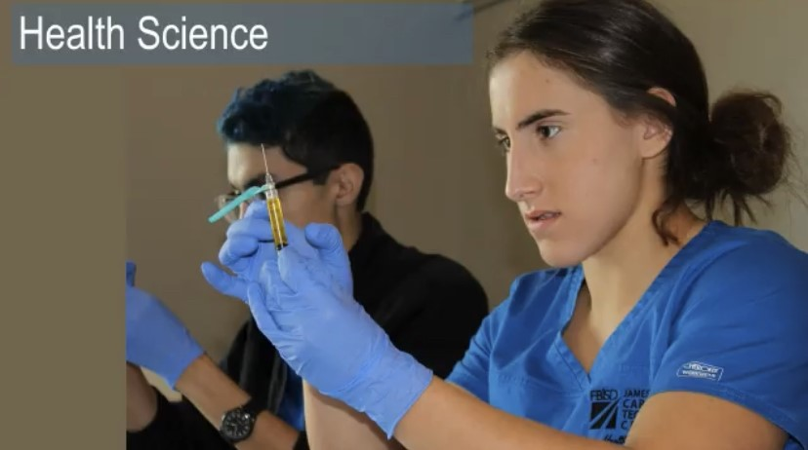

Slide 9
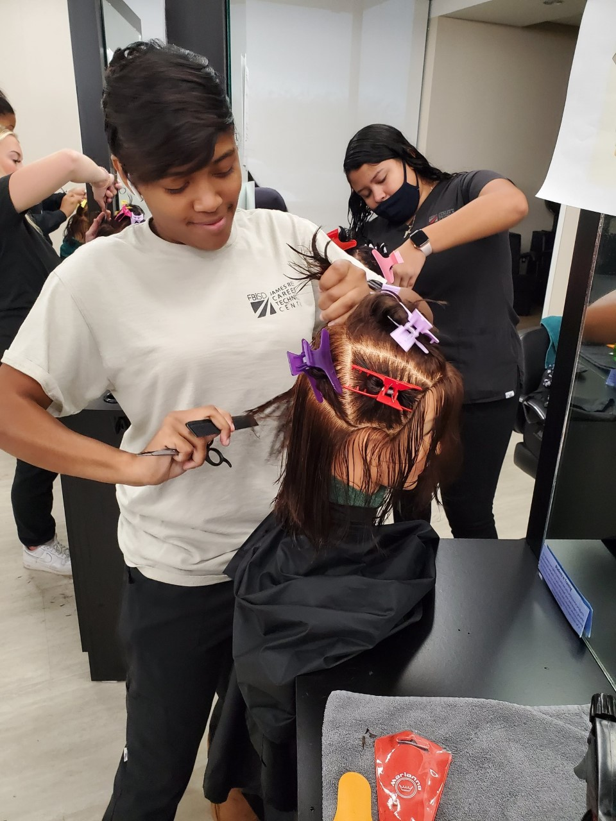
Cosmetology

Slide 10
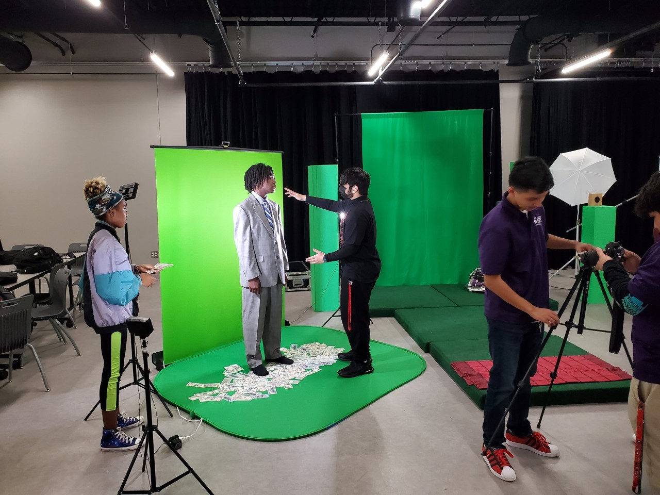
Arts & A/V

Slide 11
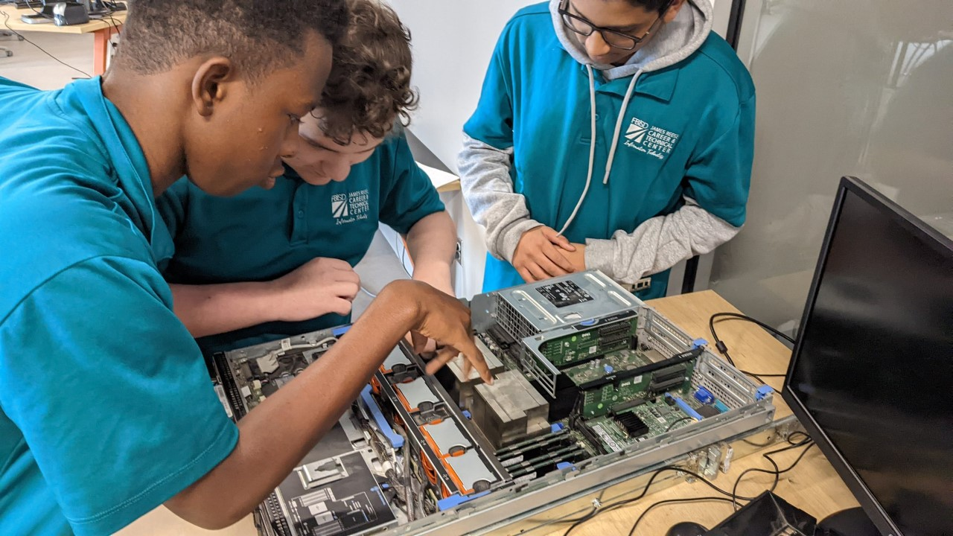
Computer Networking & IT

Slide 12
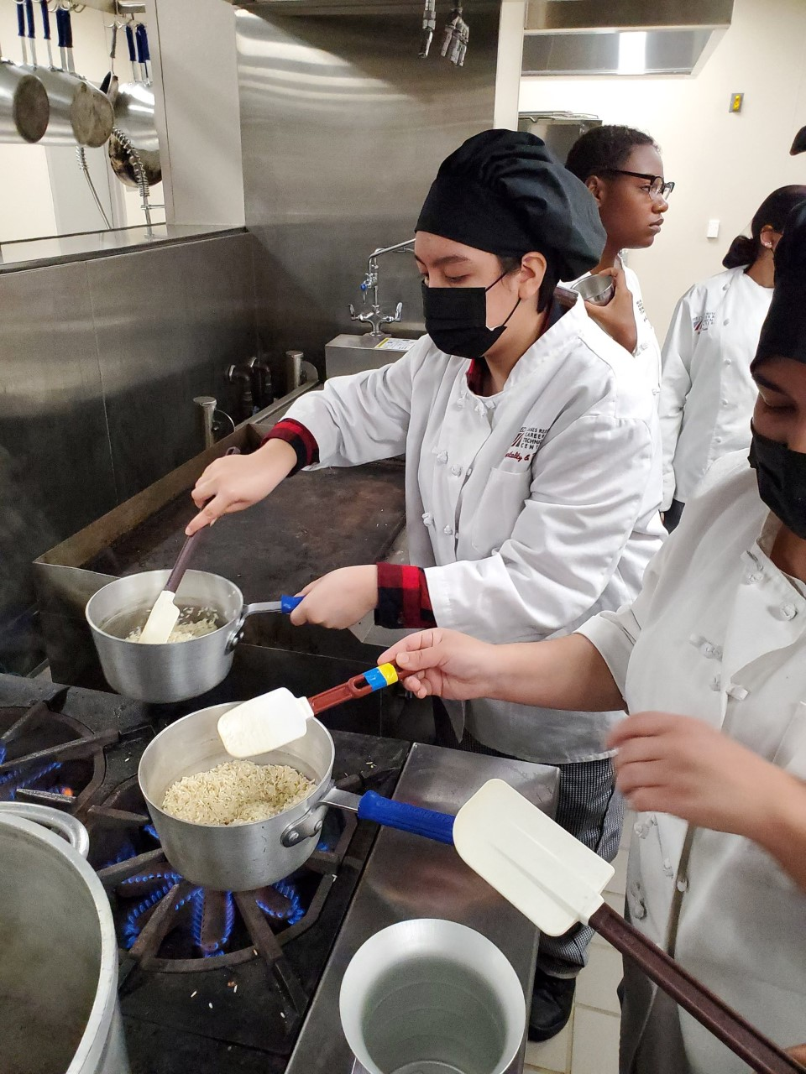
Culinary Arts

Slide 13
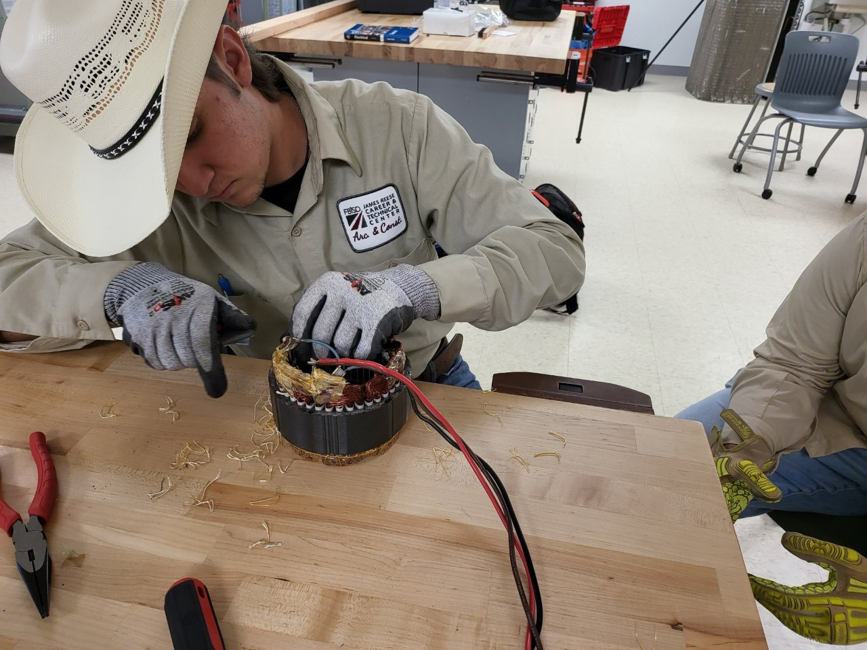
Plumbing, Electrical, & HVAC

Slide 14
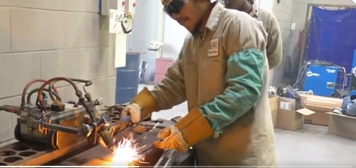
Welding

Slide 15
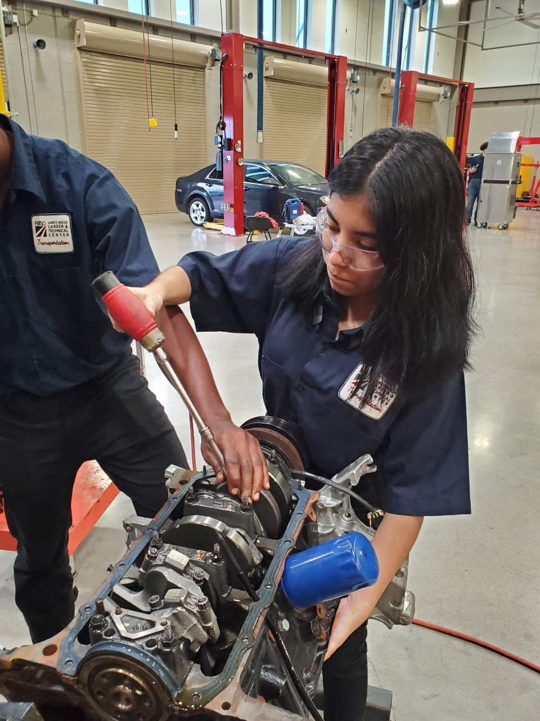
Auto and Diesel

Slide 16
Why Reese Center?
Certification opportunities, aligned with industry
Potential dual credit/licensure opportunities
Real world experiences
Work/College/Technical School environment

Slide 18
How does it work?
AM and PM Rotations/Cohorts
45 minute periods minimum (certification, dual credit, and licensing)
3 periods total at Reese
Opportunities to get hours outside of school time for some programs

Slide 19
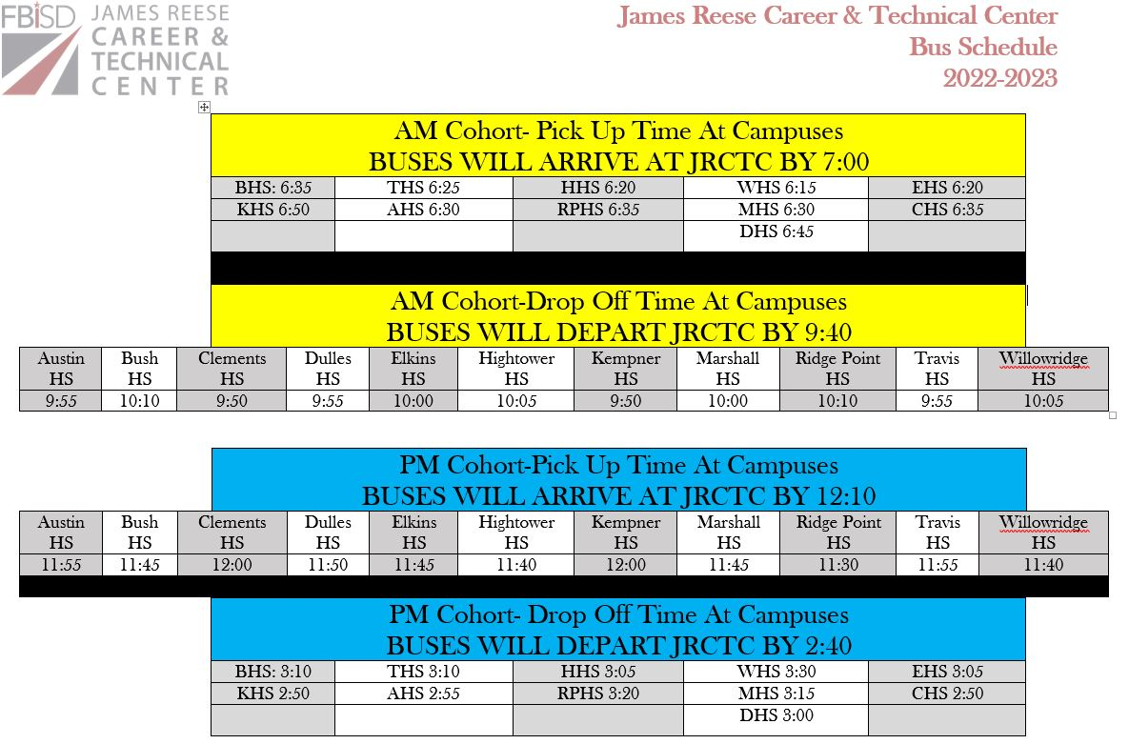
How does it work?
Transportation
Students may drive (free parking permit)
Shuttle Bus
*Schedule subject to change.

Slide 20
Uniform Requirements
Monday – Friday
Students expected to wear program-specific uniforms to class daily for all 3 periods.
Home Campus Spirit Days
Program dress is still required at Reese Center on home campus spirit days, such as Homecoming, Red Ribbon Week, etc.

Slide 21
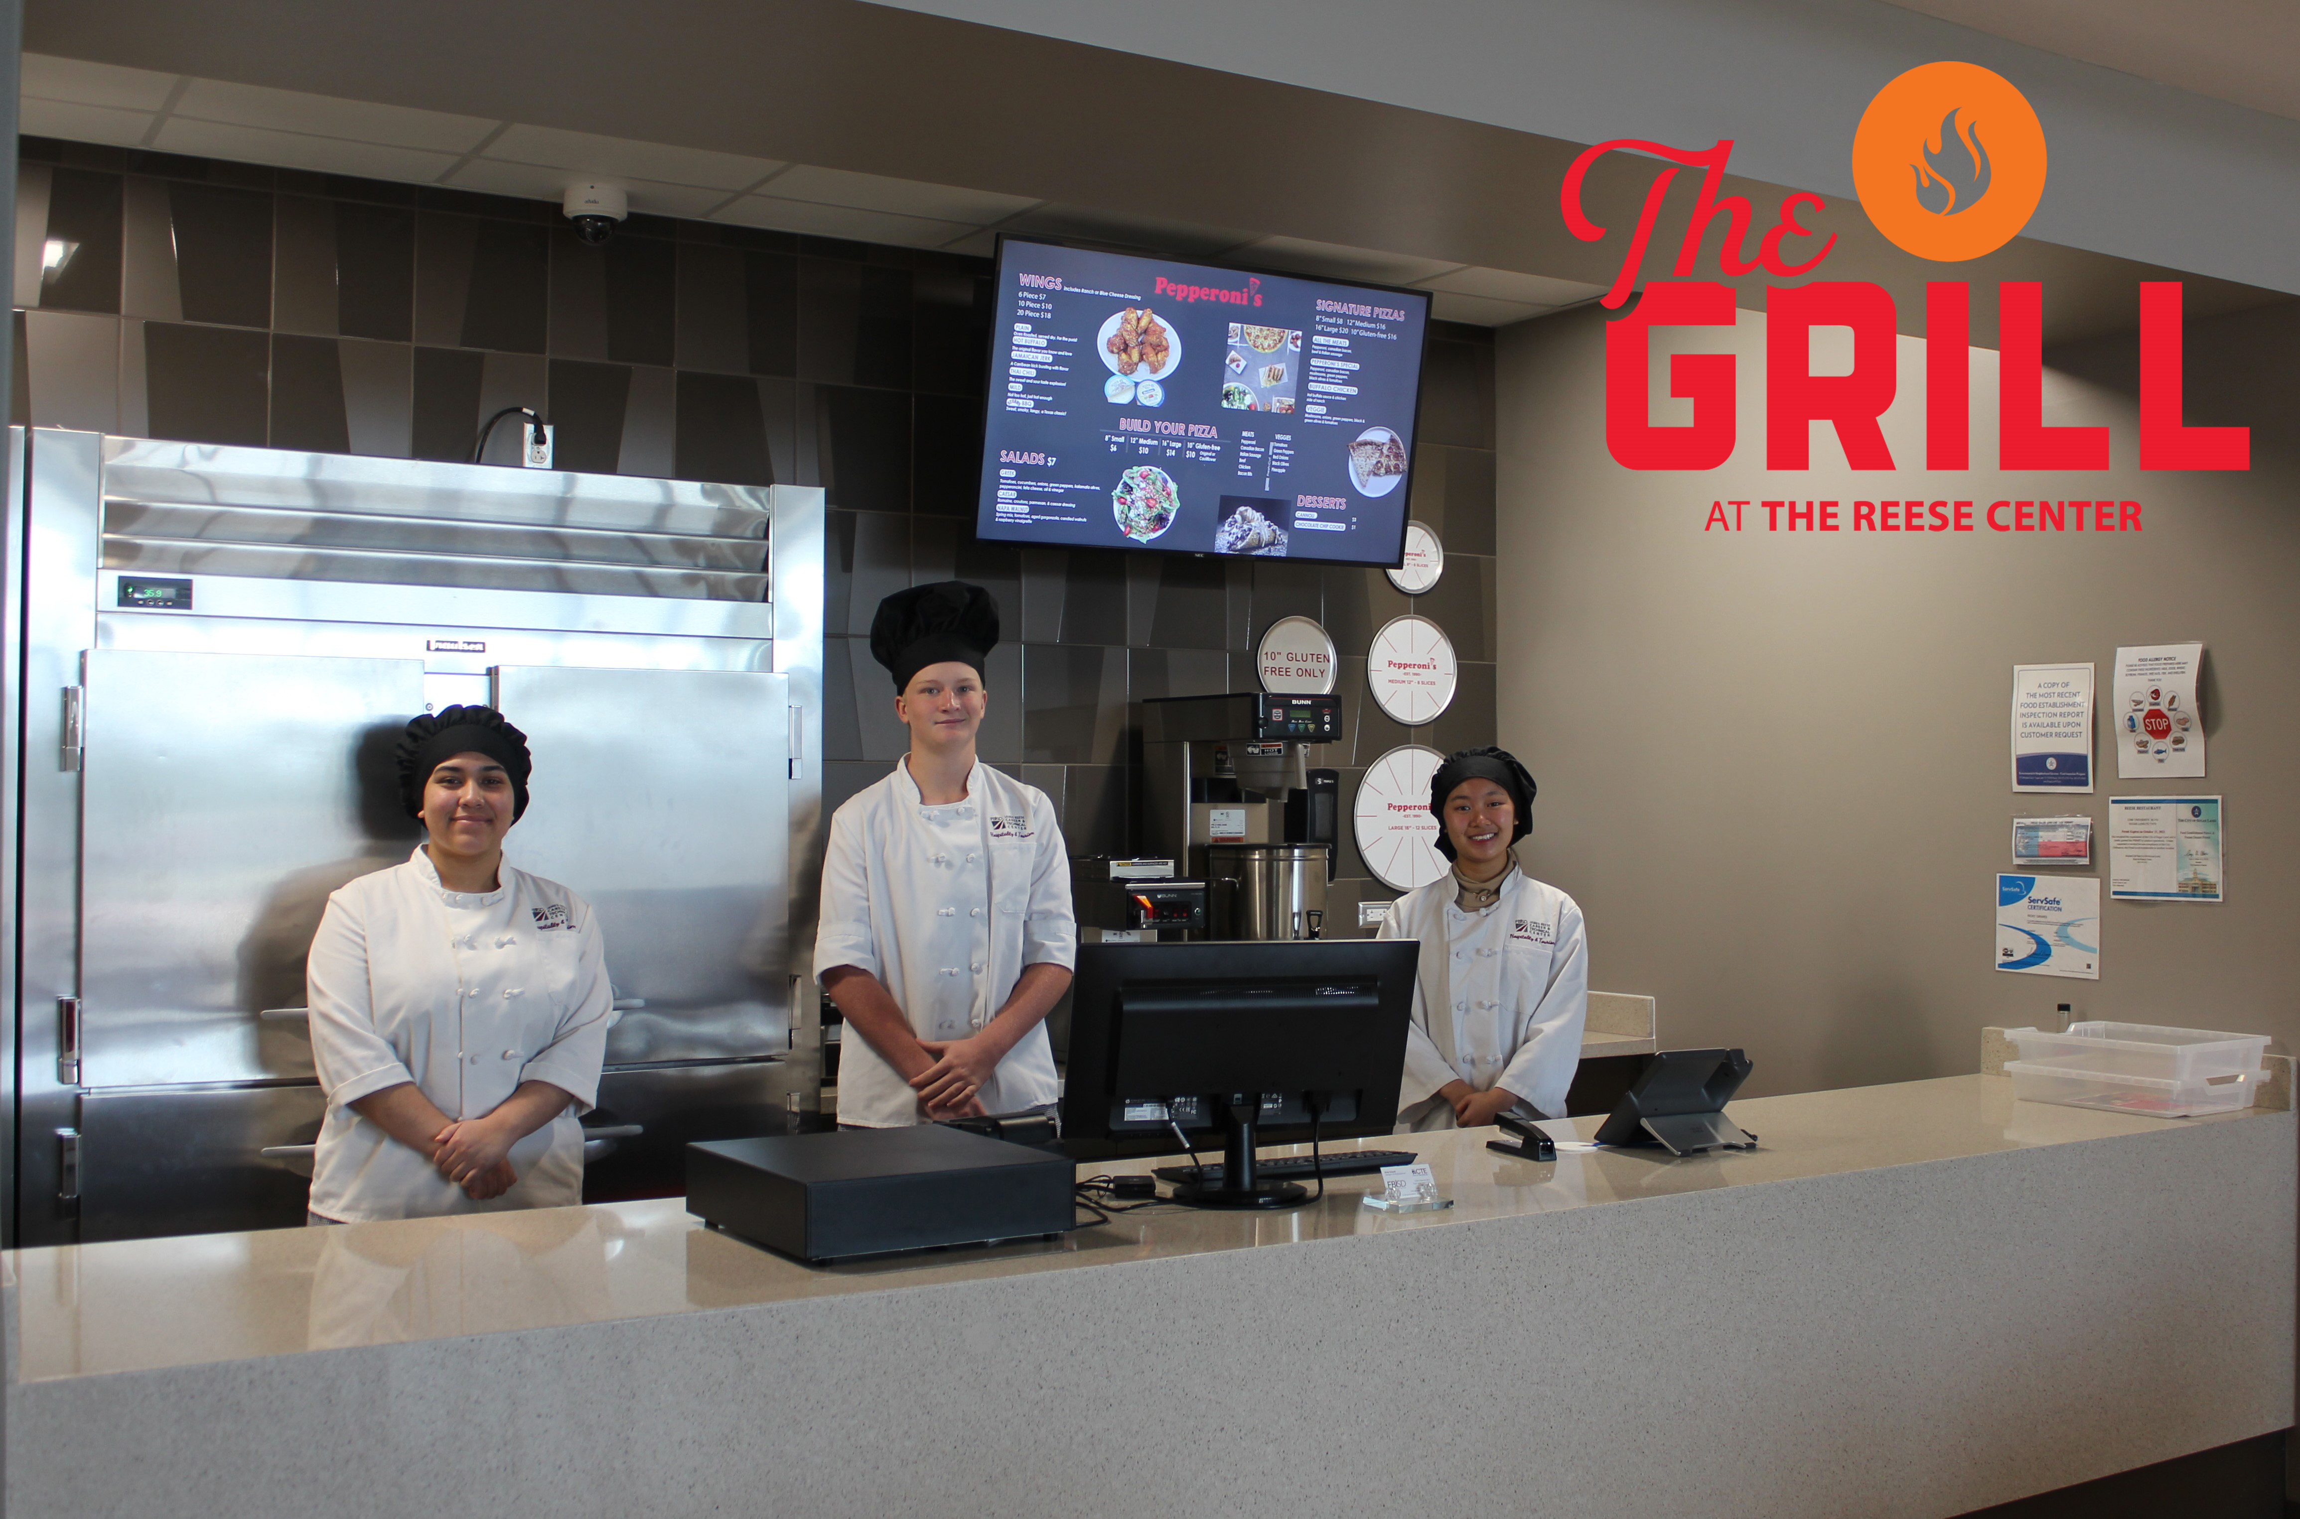

Slide 22
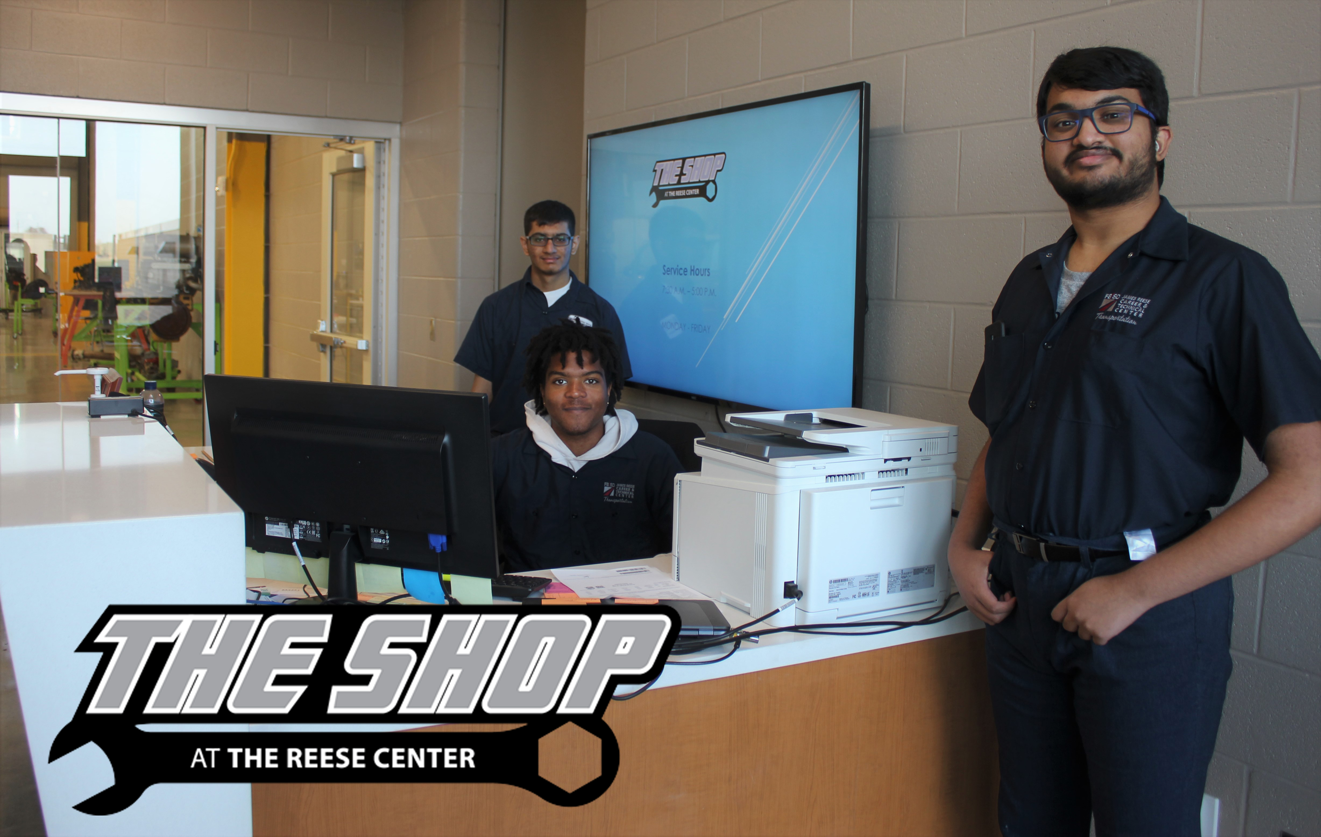

Slide 23
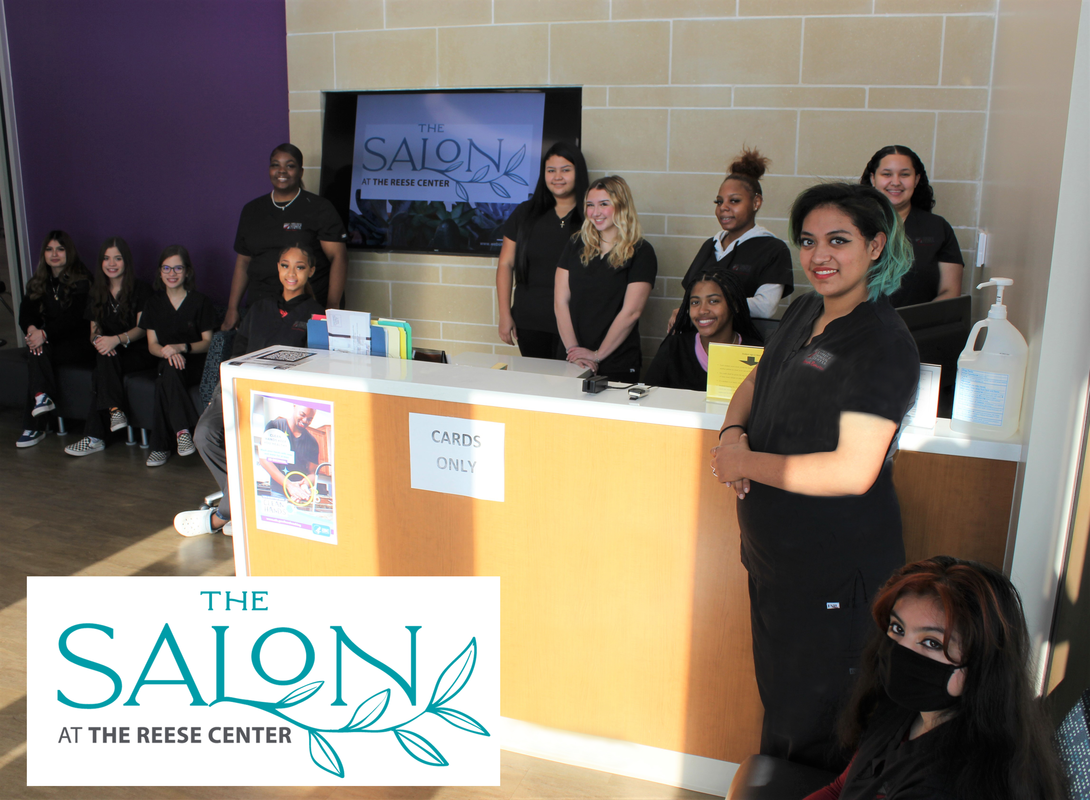

Slide 24
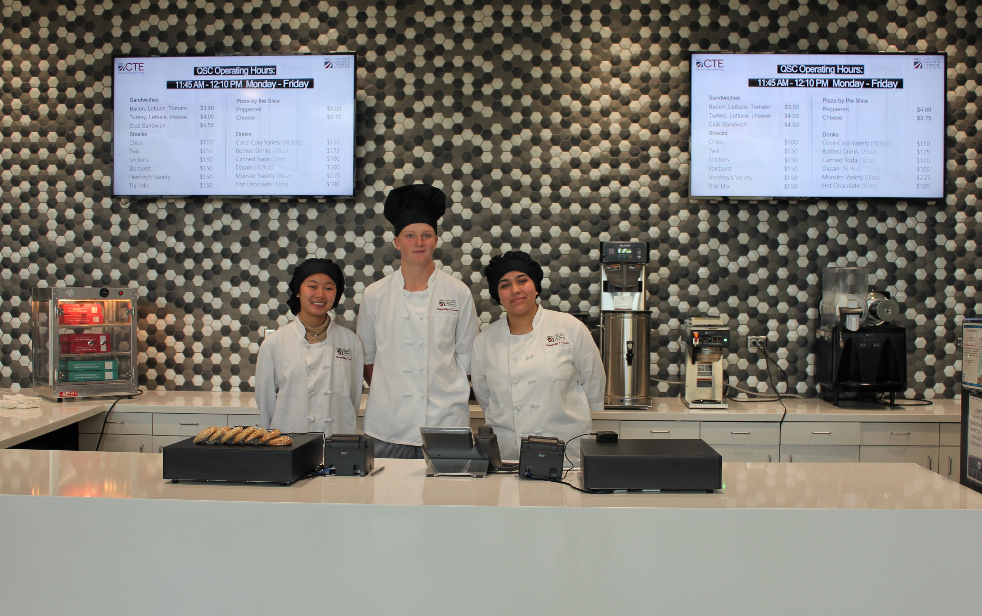

Slide 25
Current 8th-11th Graders are invited to attend!
James Reese Career and Technical Center
Experience Night
February 10th
6:00-8:00 pm
@CTEReeseCenter

Slide 26
Application Window January 18th – February 18th

Slide 27
Campus Information
JRCTC Website – www.fortbendisd.com/jrctc
Twitter – @CTEReeseCenter
Dr. Julia Erdie– Principal – Julia.Erdie@fortbendisd.com
Elizabeth G. Canchola – Associate/Asst. Principal – Elizabeth.Guerracanchola@fortbendisd.com
LaRonda Peace – Campus Secretary – Laronda.Peace@fortbendisd.com
Hasita Kartick – Attendance Clerk & Secretary – Hasita.Kartick@fortbendisd.com

